Slide 1
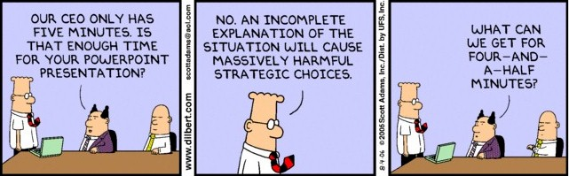
What’s so funny?
Investigating joke patterns and predicting humor
Kaitlin Puryear

Slide 2
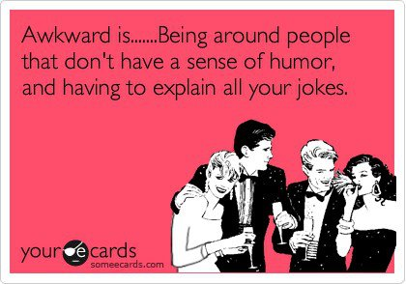
Motivation
What makes people laugh?
“Sense of humor” means different things to different people
What are the types of humor?
Is there a pattern to the construction of jokes?

Slide 3
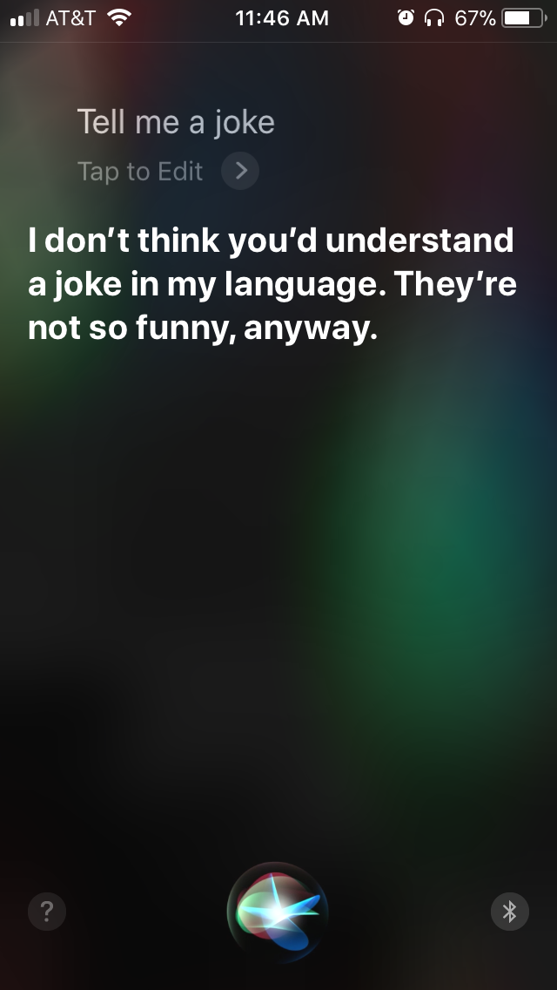
Motivation
Business Uses
Injecting humor into AI applications such as Siri or Alexa
Marketing Campaigns
Developing customer humor demographics

Slide 4
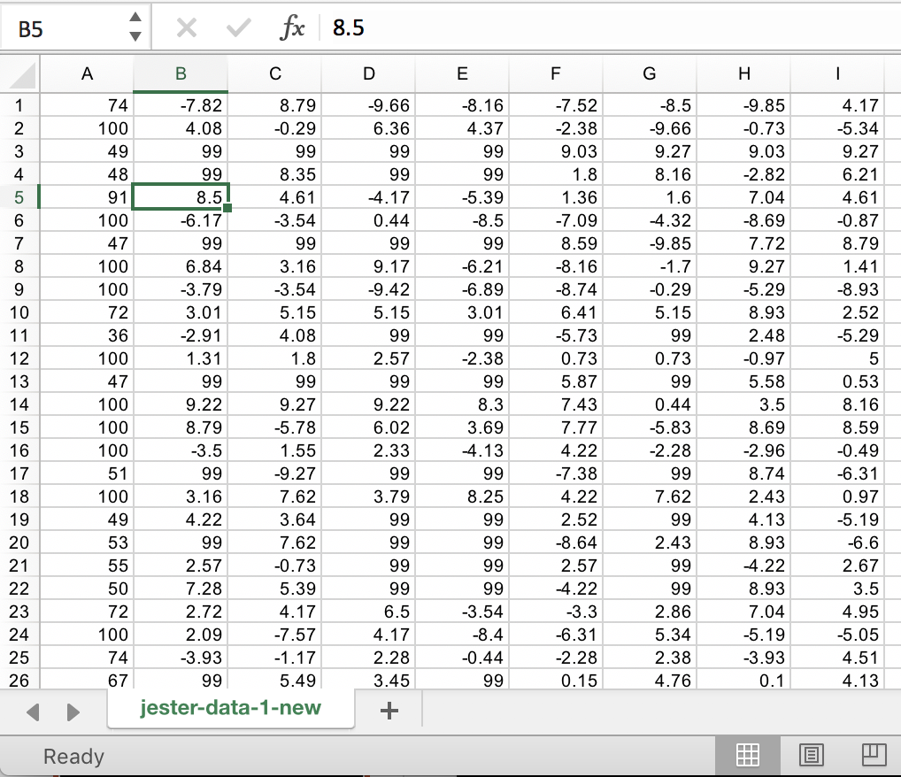
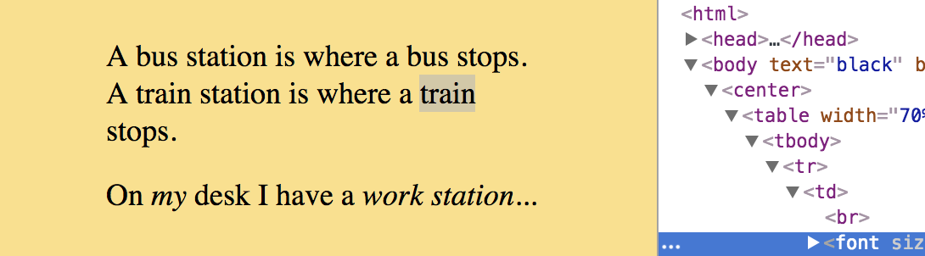
Data Acquisition
Raw data:
Csv file
Columns = 100 numbered jokes
Rows = joke ratings, rated by 24988 people
100 HTML files containing the jokes that correspond to each number
Notes:
Used beautiful soup

Slide 5
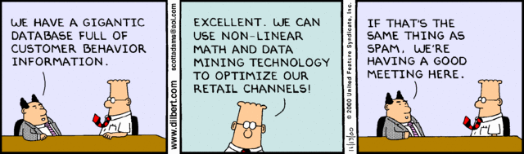
Analysis Strategy
Text Analysis
K-Means Clustering
LDA Topic Modeling
Gensim similarity analysis
Ratings Analysis
Joke Recommender
Modeled with Scikit-Surprise

Slide 6
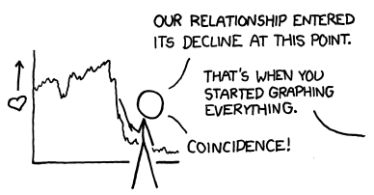
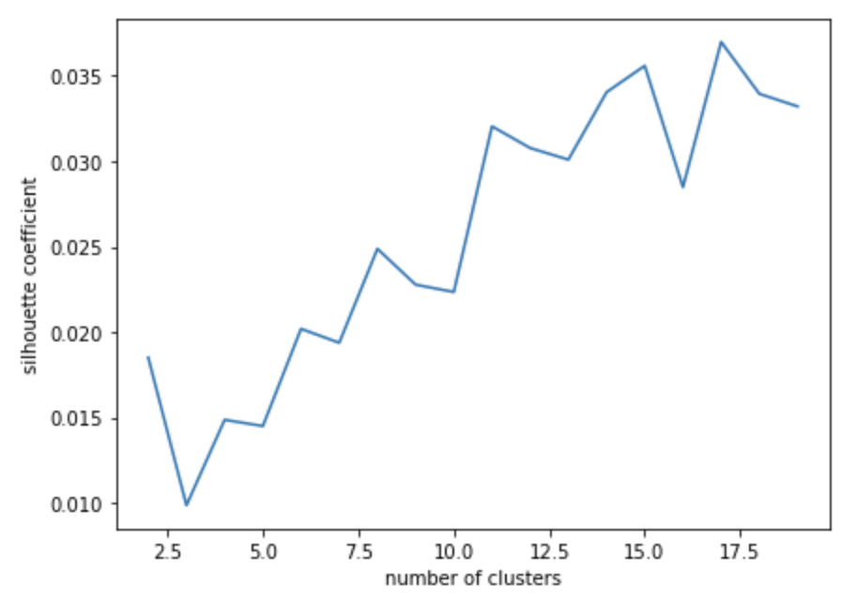
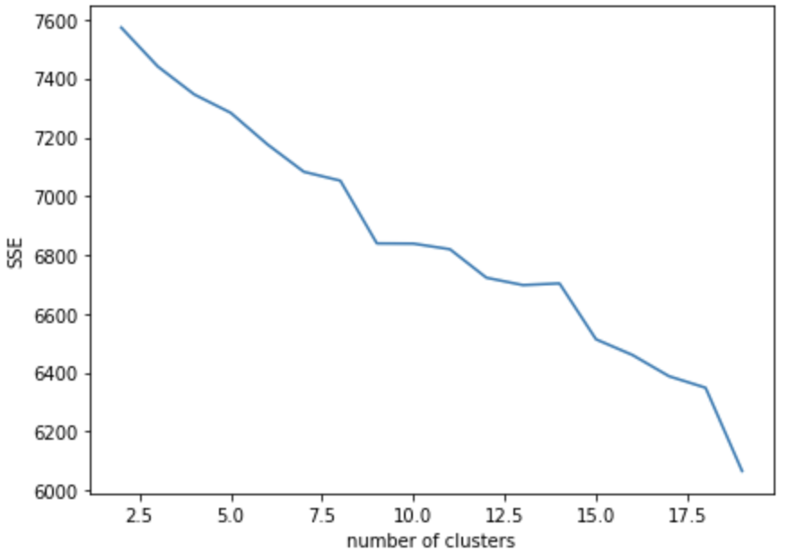
K-Means Clustering
Fix the x-axes, so you don’t have any fractions…
“How many types of jokes are in this dataset?”
Notes:
Kmeans on TFIDF. TFIDF takes into account how many times any word is said, negates words that are repetitive and over-said.

Slide 7
K-Means Clustering
“How many types of jokes are in this dataset?”
Notes:
11 clusters! That is good to know.

Slide 8
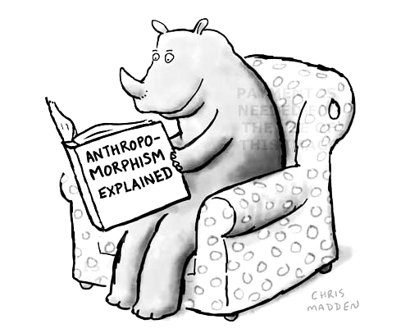
LDA Joke Topics
“What are these jokes about?”
Exclamations, nonsense words and words out of context
Non-US Nationalities
Family Drama
Jokes about religion
Children’s lives/children’s point of view
Married life
Jokes about women
Jokes about education
Jokes about infidelity
“Screw in a lightbulb”
“Good News/Bad News”
Notes:
Latent Dirichlet Allocation, which is an algorithm that takes in documents (jokes) and groups them into topics
Used KNN value to motivate my LDA topic choices

Slide 9
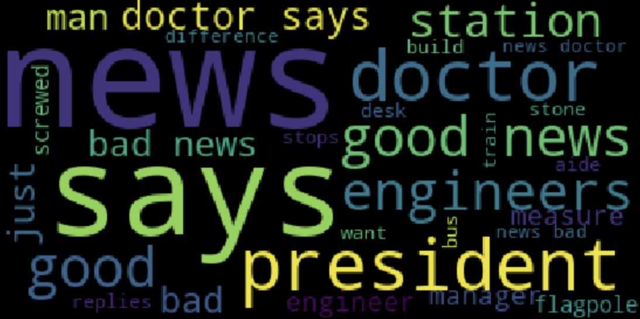
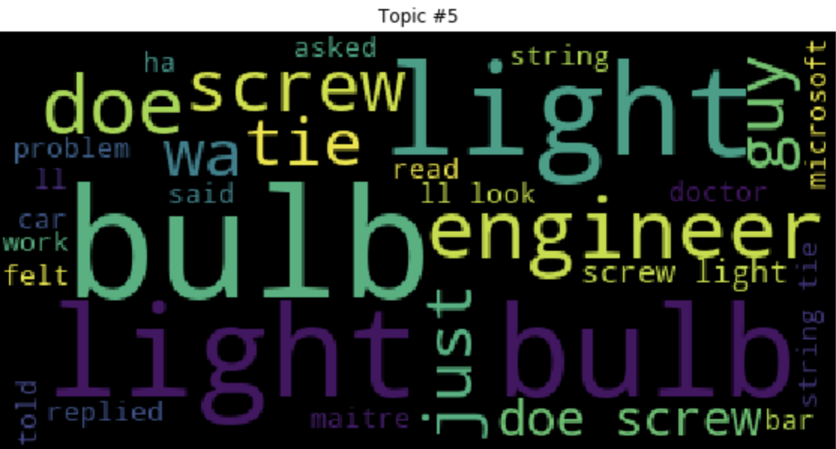
“How many does it take to screw in a lightbulb…”
Literals

Slide 10
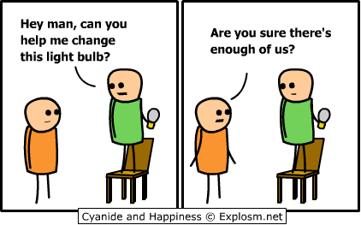
“How many does it take to screw in a lightbulb…”
Literals

Slide 11
Literals
“I’ve got some good news, and some bad news…”

Slide 12

Literals
“I’ve got some good news, and some bad news…”

Slide 13
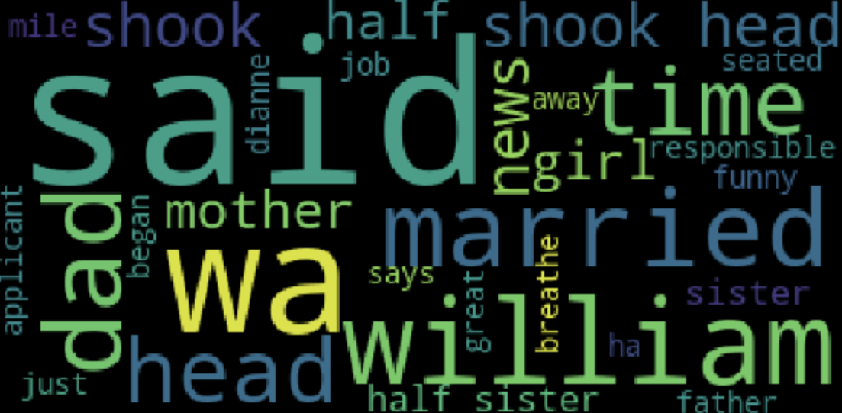
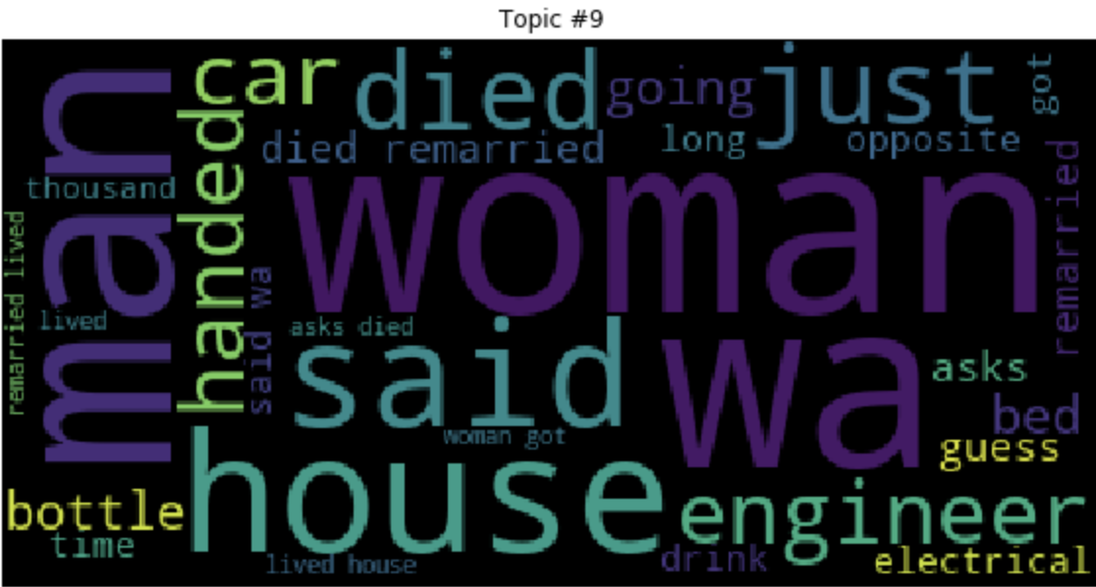
Married life
Jokes about…
Family Drama

Slide 14
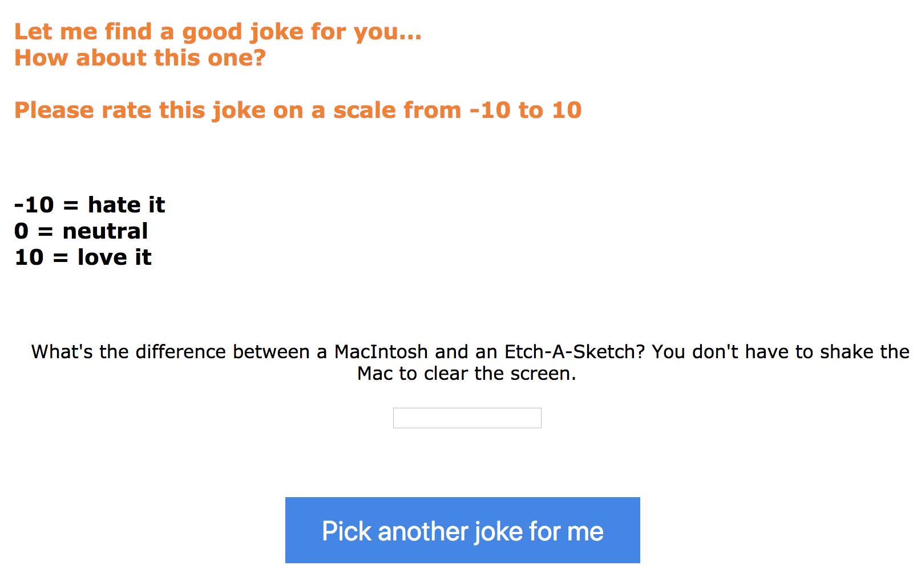
Joke Recommending
Scikit-Surprise package
SVD and KNN algorithms (KNN)
RMSE = 1.2
Collaborative Filtering

Slide 15
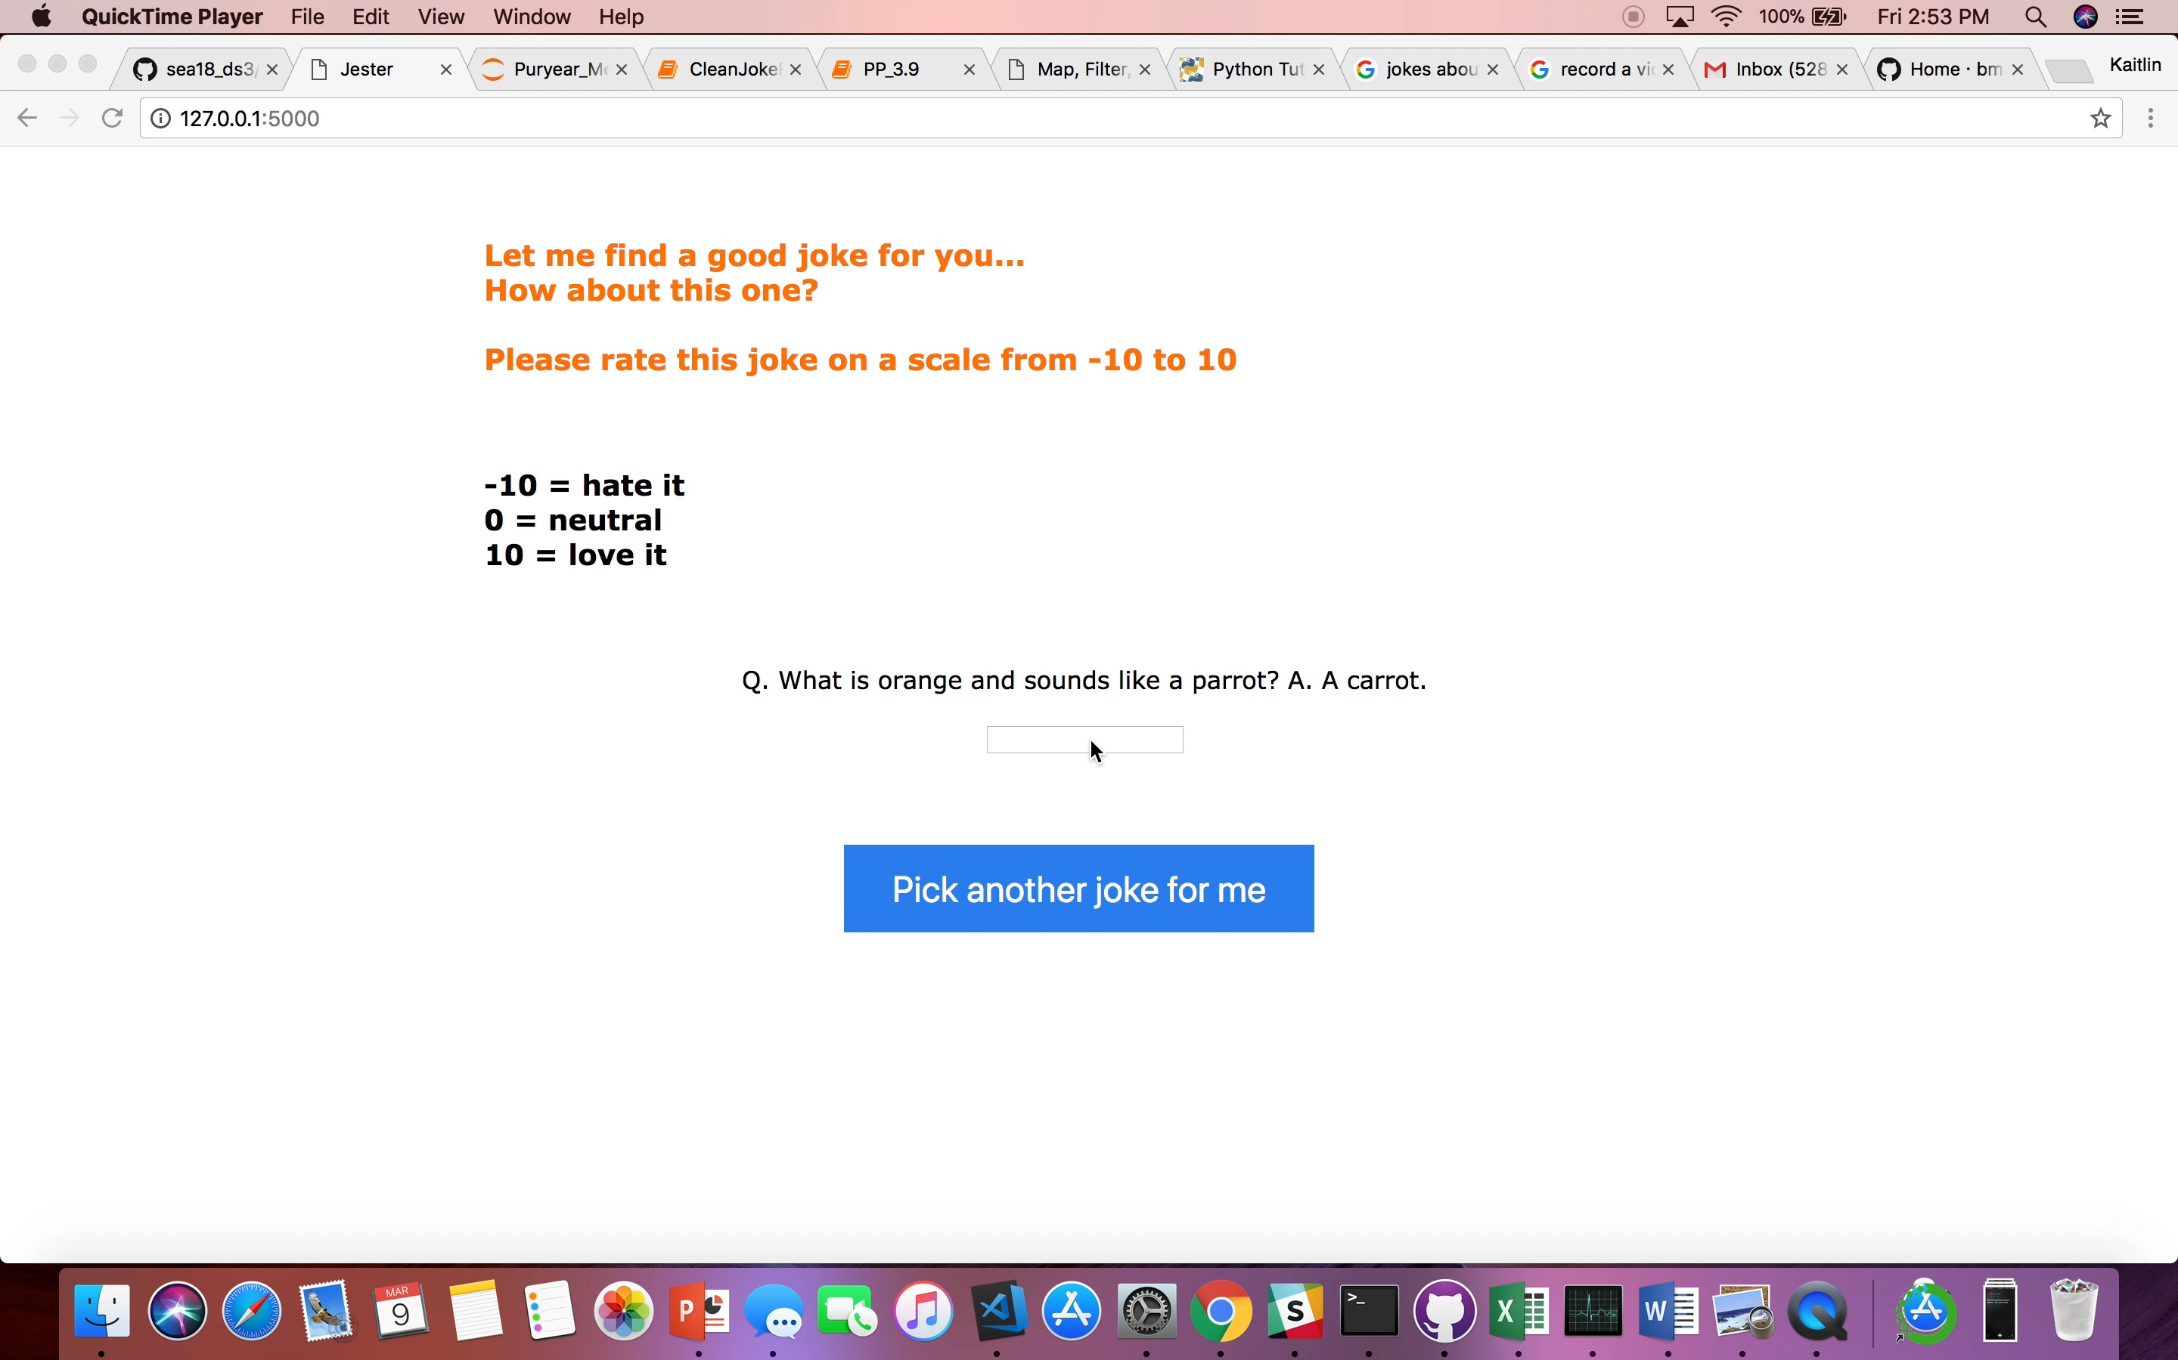

Slide 16
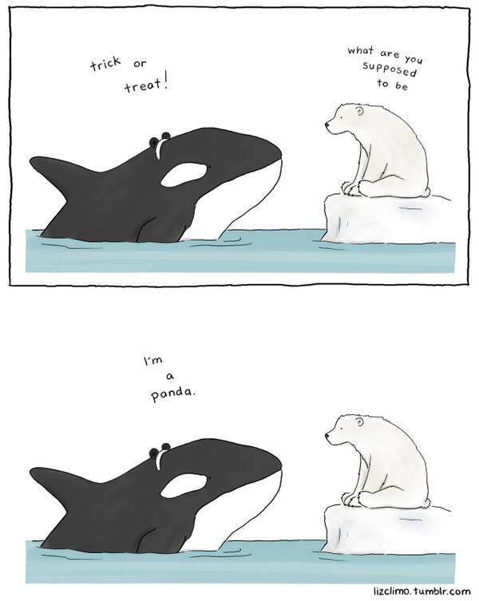
Conclusions
Jokes can be classified into 11 distinct categories based on topic
Joke recommender can predict a good joke for any user
Marketing teams can use this to make their advertising campaigns more friendly and relatable

Slide 17
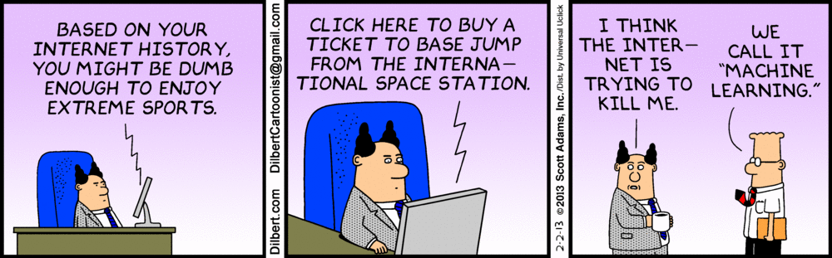
Questions?

Slide 18
Extra Slides…

Slide 19
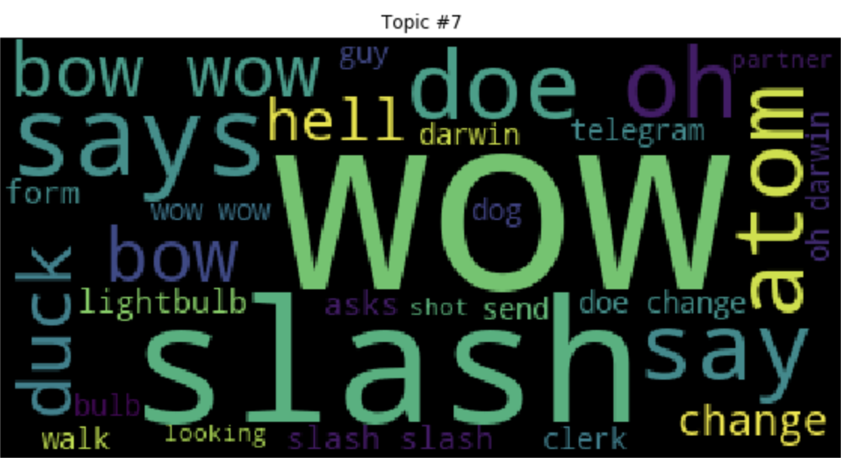
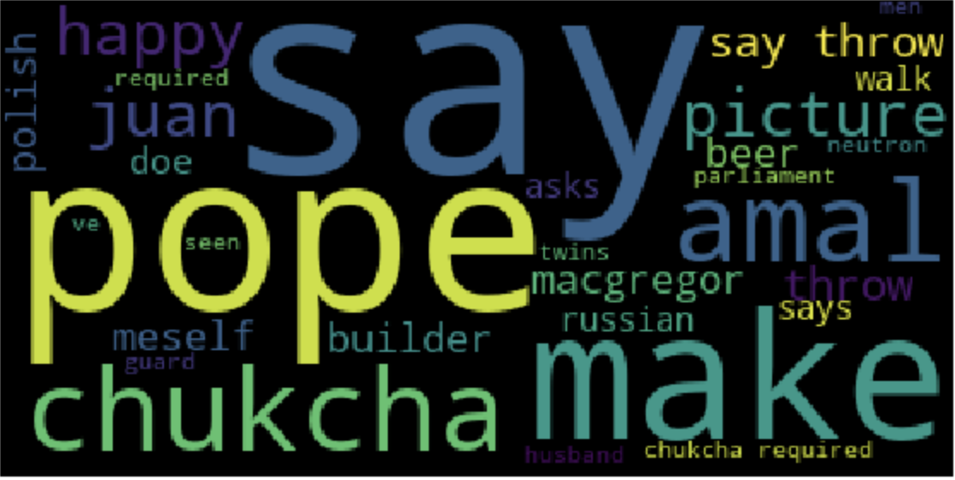
Non-US Nationalities
Jokes about…
Exclamations, nonsense words and words out-of-context

Slide 20
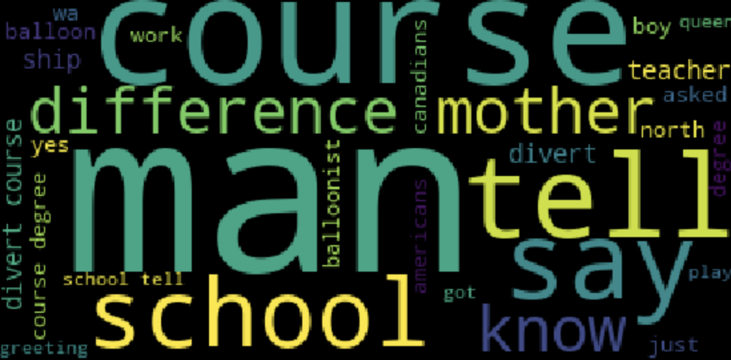
Jokes about…
Children’s imagination

Slide 21
Exclamations and out-of-context words

Slide 22
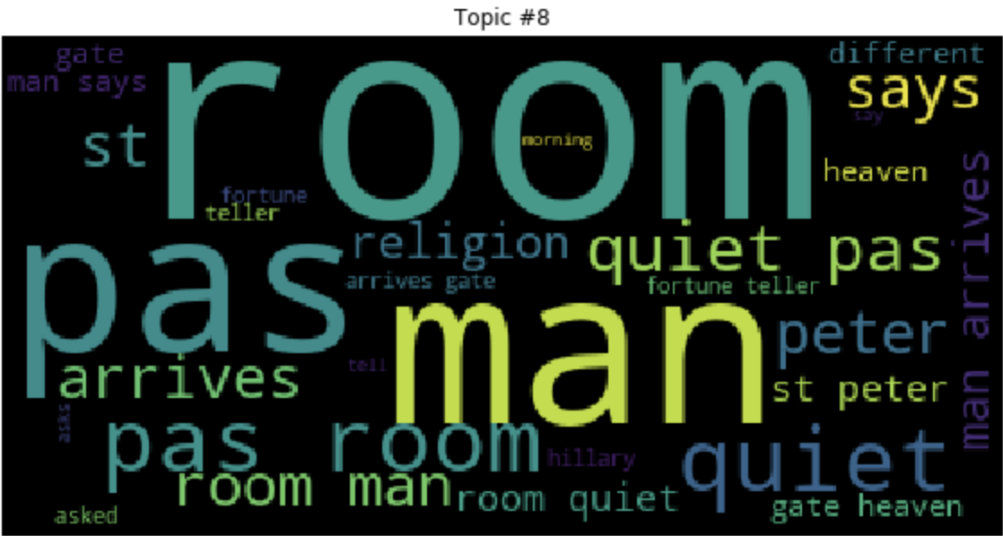
Jokes abt religion

Slide 23
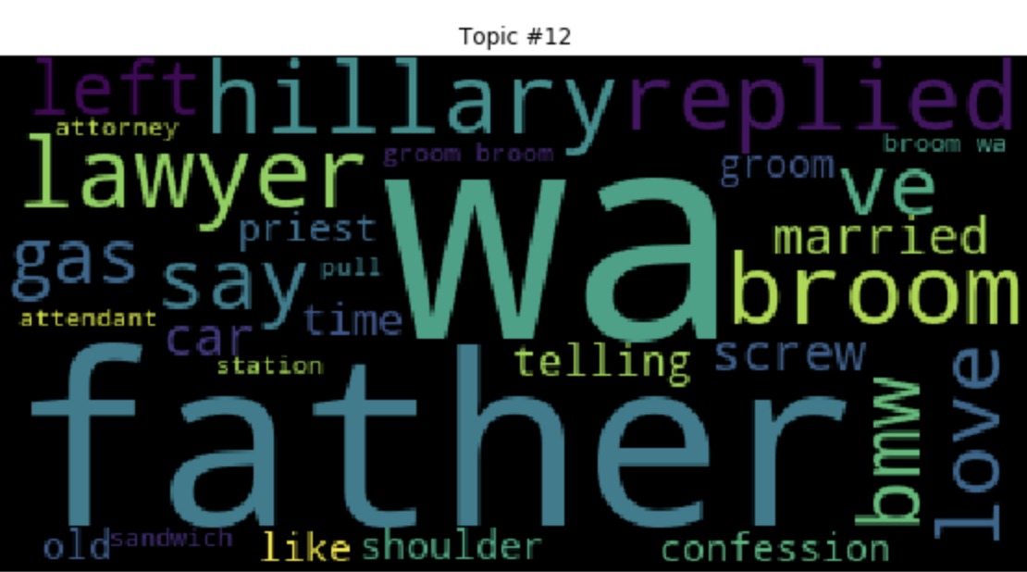
Jokes about infedelity

Slide 24
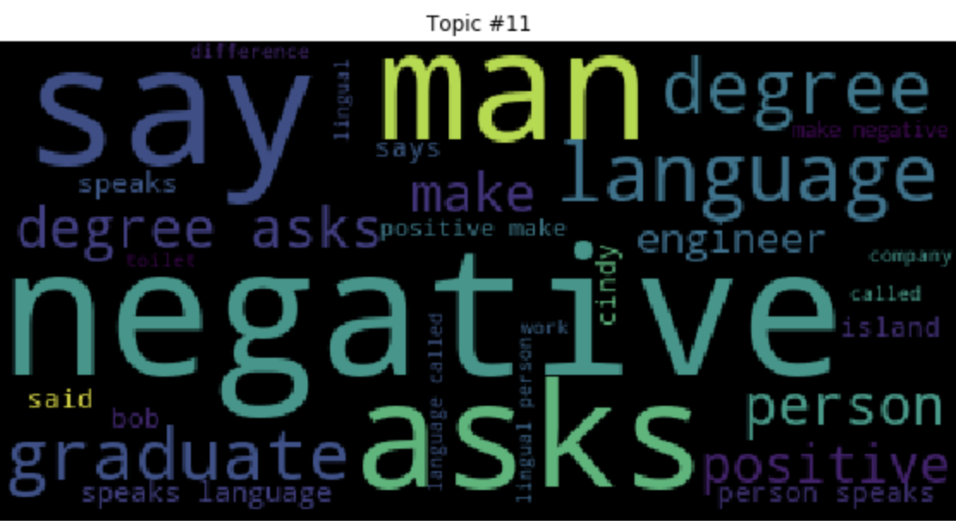
Jokes about education

